Slide 1
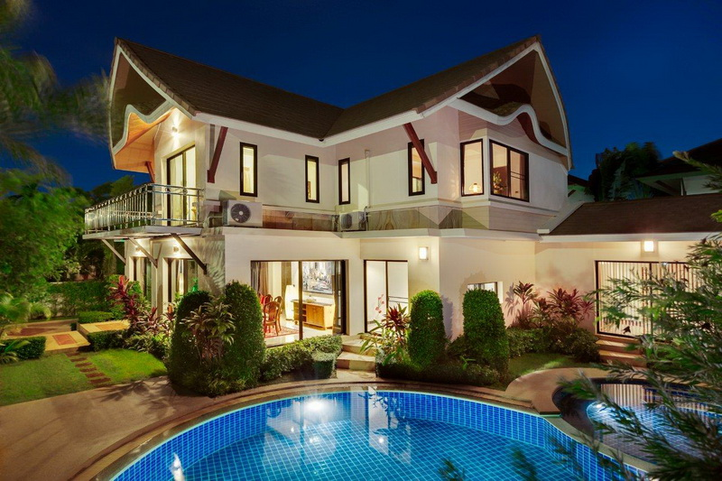
My Ideal house

Slide 2
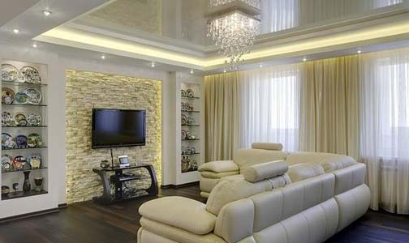
It’s a living room

Slide 3
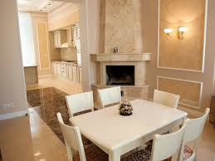
A beautiful dining room, which unfolds into a kitchen

Slide 4
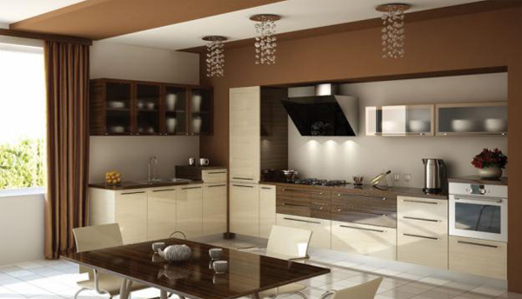
A kitchen has all modern equipment for cooking and the time spending here is imperceptible

Slide 5
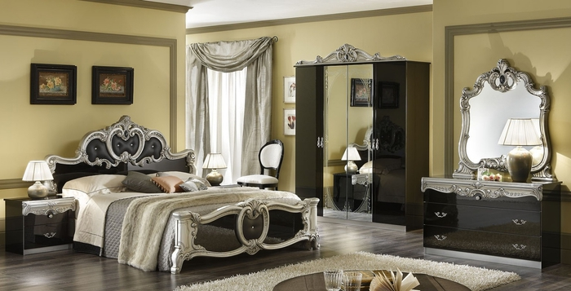
A bedroom with dark furniture

Slide 6
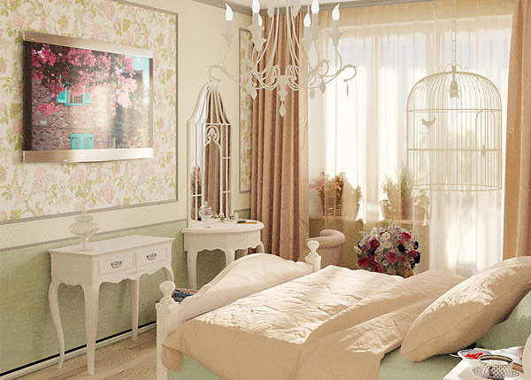
It’s a bedroom in a Provence style and in
a bright tint

Slide 7
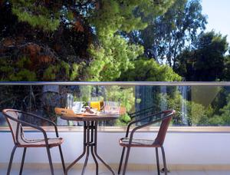
It’s a balcony with a wonderful scenery from it

Slide 8
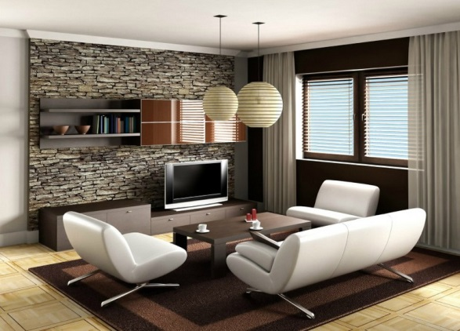
It’s a reception room , the best space for socializing with friends

Slide 9
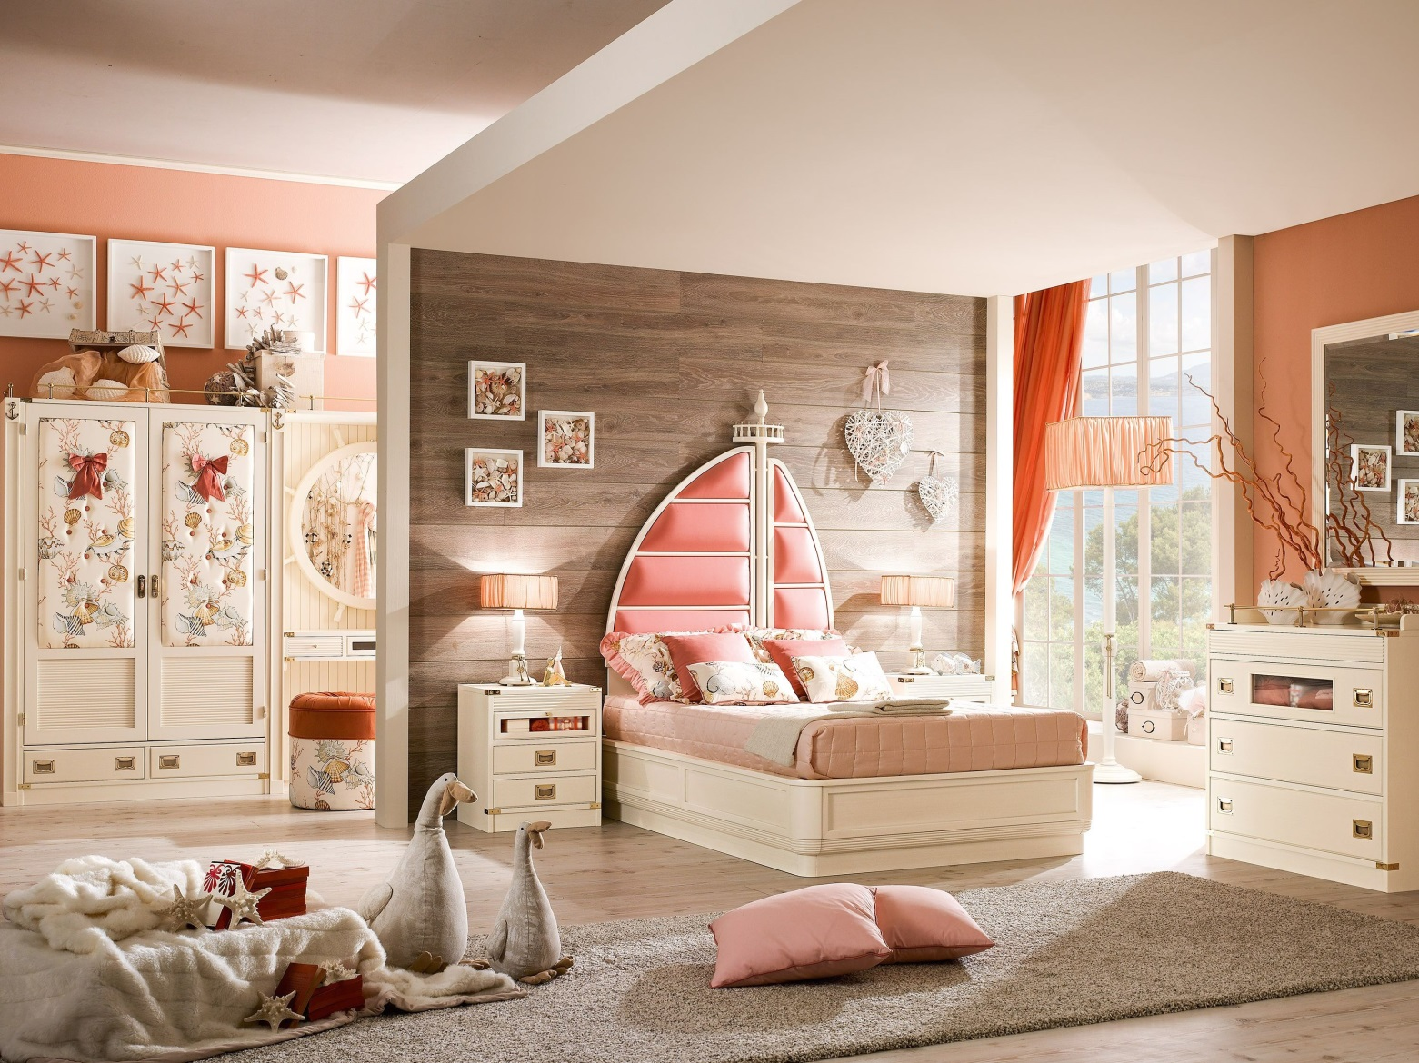
It’s a fascinating nursery for children

Slide 10
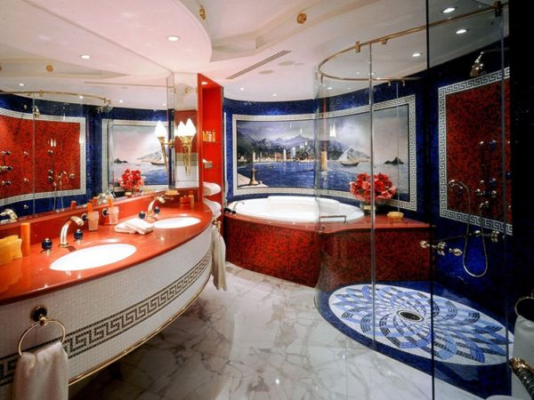
It’s a colourful and well-designed bathroom with a spa tub

Slide 11
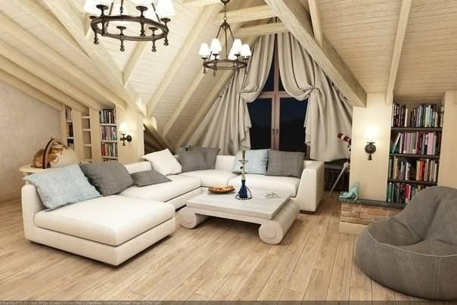
It’s a restroom for having relaxation

Slide 12
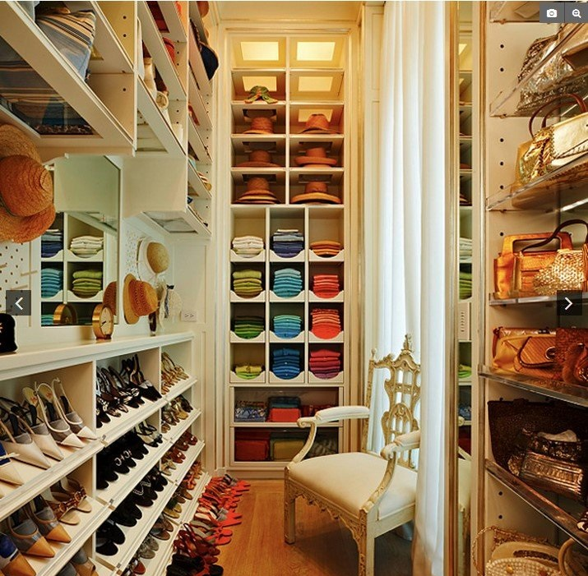
It’s a cloakroom ,which is
like a paradise for every woman

Slide 13


Thank you for attention

